Slide 1
HAWAII STATE PUBLIC CHARTER SCHOOL COMMISSION Applying to become a Public Charter School in Hawaii
September 30, 2016

Slide 2
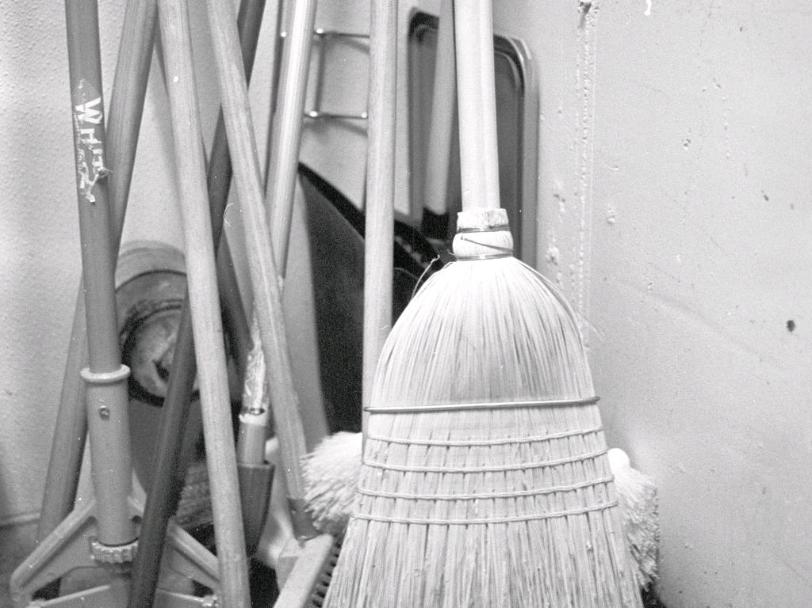
HOUSEKEEPING
Virtual attendees: Please remain muted
Instructions for asking questions (also located on the back of your agenda).
All materials will be posted online.
cc: bcostin - https://www.flickr.com/photos/48441030@N00
Notes:
With a relatively small group, we ask that everyone come and sit around the table. We would like for this RFP orientation to be much less formal and more of a conversation, so please feel free to ask questions and get comfortable. Restrooms are around the corner near the elevators. For those attending on-line, you will be muted until we open up the line for questions. Online participants should use the raise their hand function to ask questions. Let everyone know that all of the materials are posted on the Commission's website under the "starting a school" tab.

Slide 3
INTRODUCTIONS
cc: porschelinn - https://www.flickr.com/photos/54144062@N03
Notes:
Commission Staff, please identify and introduce yourselves to everyone in the room. Then let’s go around the table and ask each person to identify themselves and their role in attending this orientation session.

Slide 4
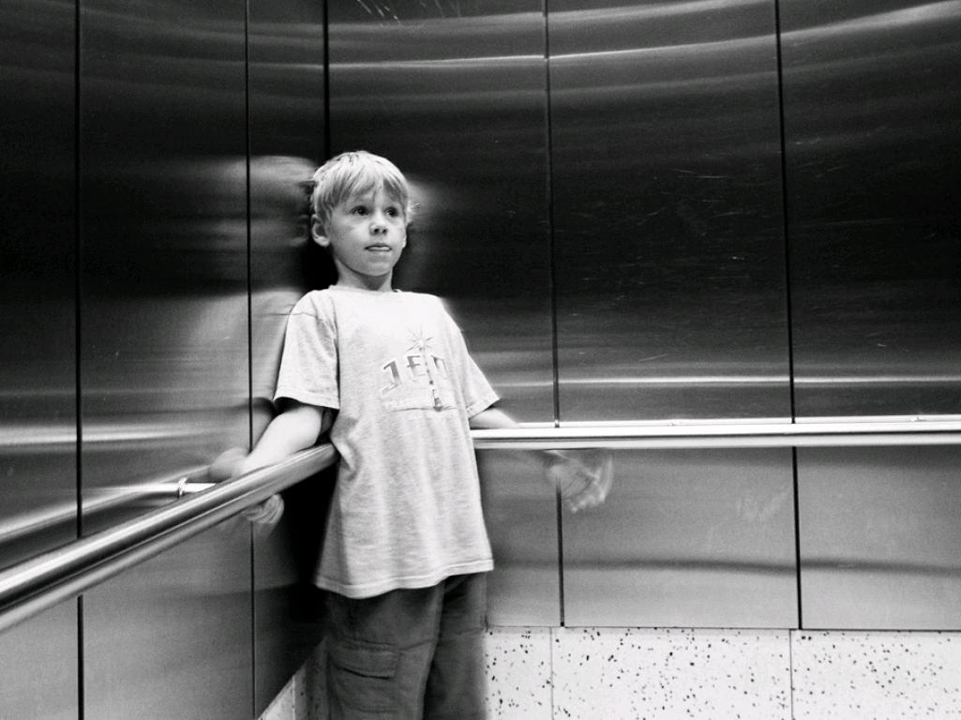
WHAT'S YOUR 2 MIN. ELEVATOR SPEECH?
cc: dbrekke - https://www.flickr.com/photos/26223800@N00
Notes:
Icebreaker exercise: As part of writing and presenting a successful application for a Public Charter School, we have found that an Applicant team should be able to hone their application down to a short presentation. A 2 minute elevator speech if you will... We are passing out an applicant information sheet that asks some basic questions that each of you should be able to answer once you have completed your application. Take the next 10 minutes to meet with your team and fill in the information and work together to present a short 2 minute elevator speech . . .

Slide 5
???
What unique educational opportunities will your school provide?
Describe the key components of the educational model, including a brief explanation of how it will drive success for the identified student population.
Describe the expected outcomes for the students in both the short run--after they graduate from your school-- and in the long run as contributing members of our community.
cc: Seth Capitulo - https://www.flickr.com/photos/61176293@N05
Notes:
For each Applicant, in your presentation, please include these three things.

Slide 6
WHAT'S YOUR 2 MIN. ELEVATOR SPEECH?
cc: dbrekke - https://www.flickr.com/photos/26223800@N00
Notes:
Is everyone ready? Need more time?
Who would like to go first…

Slide 7
ROADMAP FOR TODAY
Applying The Application Commission Decisions
Your contact from here on out: LAUREN ENDO
lauren.endo@spcsc.hawaii.gov
Phone: (808) 586-3881
cc: amsfrank - https://www.flickr.com/photos/37818606@N00
Notes:
So, let’s give you the roadmap for what we will be doing today for the next four hours! From here on out, if Applicant Teams have questions, please contact Lauren Endo. She will be your contact and guide through this process. You should not be contacting anyone else at the Commission. If you have any questions, Lauren will be the person who be your liaison.

Slide 8
Something to consider:
Delivering a high-quality public education program is very hard.
cc: Le Singe - https://www.flickr.com/photos/34632822@N00
Notes:
So, did I mention, that starting, opening and maintaining a public charter school is a very difficult endeavor? Think of the most difficult thing you have ever done in your life . . . Now imagine it being a thousand times worse!
Truly, it is not something for the faint of heart, and while the payoff in seeing the amazing outcomes for students is undoubtedly priceless, it will be a difficult journey. We are lucky to have later today, Buffy Cushman-Patz, School Director for one of our newest Charter Schools, SEEQS: the School for Examining Essential Questions of Sustainability come to speak with and share with you her experience and journey in applying, opening, and maintaining a public charter school.

Slide 9
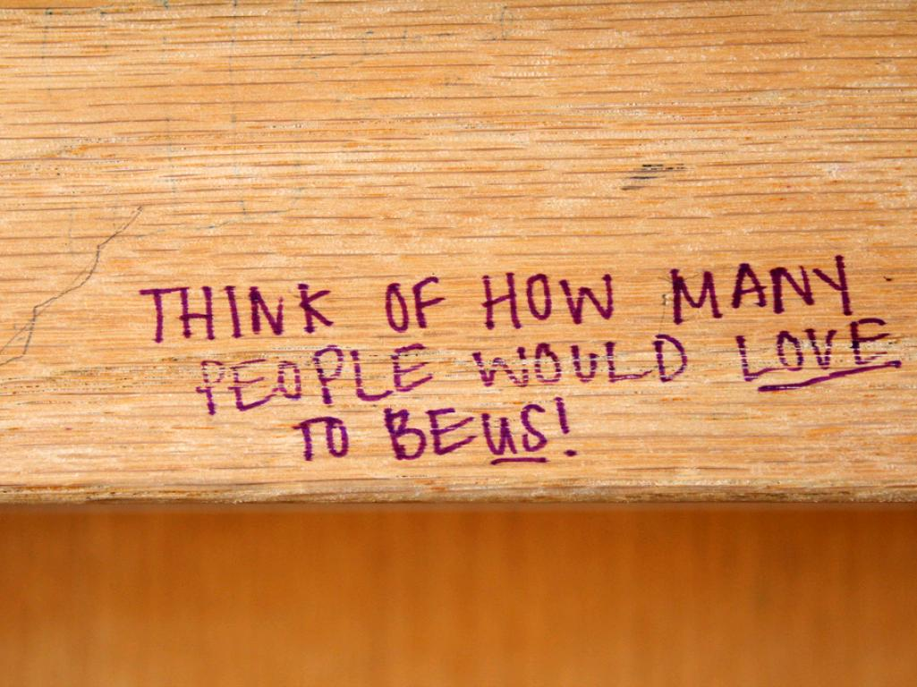
Receiving a Charter is a privilege
cc: quinn.anya - https://www.flickr.com/photos/53326337@N00
Notes:
Applicants should understand that receiving a charter to open and operate a Public Charter School is truly a privilege and not an entitlement. What you are getting is the freedom to deliver education in a different way from the regular Department public schools, but you are just as accountable for the outcomes for your public school students as any other Department School. You should have HIGH EXPECTATIONS for these students.
While you will have freedom in the delivery of your education program, as a state entity, you will however be required to still do a lot of things that all other state agencies have to do. For example, the state will pay for your employee benefits and as such, the Employer Union Trust Fund (the agency that provides the medical insurance for all state employees) as well as the Employee Retirement System (ERS) requires all public charter schools to report specific employee payroll and personnel information to them on a regular basis. There are somethings that all public charter schools will be required to do and will not allow for changes or “innovations.”

Slide 10
IT'S ABOUT THE STUDENT
AND PARENT’S CHOICE TO ATTEND A CHARTER SCHOOL
cc: imayellowfellow - https://www.flickr.com/photos/28792936@N05
Notes:
Remember that Public Charter Schools are about providing another choice of public education to each public school student. It is giving the student another option for learning to and ideally beyond the standards set by the state. Charter Schools are given the privilege to do that in their own unique and innovative way. Charters offer also an opportunity to demonstrate and provide new ideas and ways of delivering education that can and hopefully will inform the broader public school system.

Slide 11
STARTING A CHARTER SCHOOL
IS BUILDING AN INSTITUTION THAT OUTLIVES YOU . . .
cc: sake028 - https://www.flickr.com/photos/46427634@N06
Notes:
So remember that by the time you complete your written application you not only have described a strong Academic Plan that tells us WHAT you are going to do and HOW you are going to do it, but also that your unique Academic Plan is financially viable, and Operationally feasible. No ONE person will be successful in getting an Application for a Charter School approved. You will need to demonstrate through your written application as well as in your Capacity Interview and presentations about your proposed charter school that you have the collective capacity to open, operate, adapt, and successfully maintain your charter school. Successful schools will survive their founders and founders need to be able to pass on responsibilities to the Institution that will become a high quality Public Charter School.

