Slide 1
Organizational Plan

Slide 2
Governance
Organizational Performance Management
On-going Operations
Student Recruitment, Admissions, Enrollment
Geographic Location and Facilities
Start-up Period

Slide 3
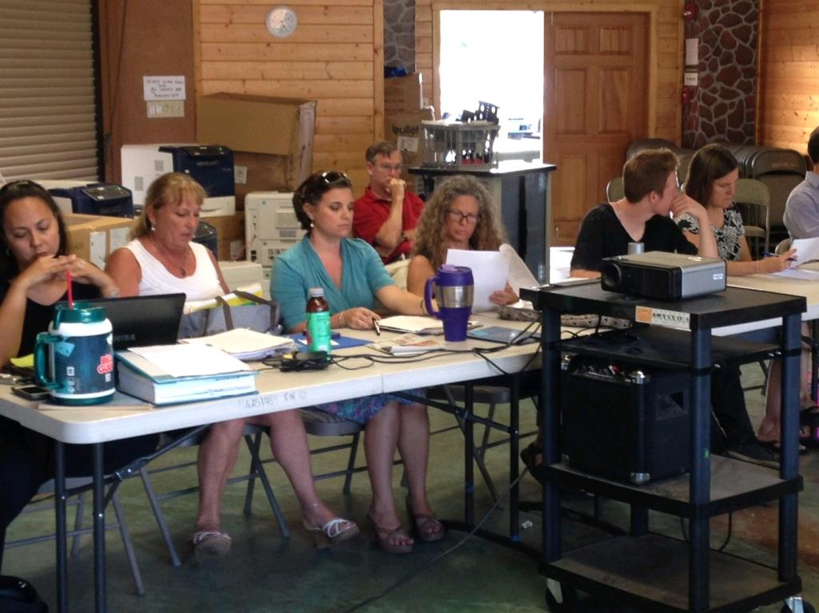
Governance = Oversight = Commitment = Stewardship

Slide 4
Open Admissions
School of Choice
cc: Randy Heinitz - https://www.flickr.com/photos/36509286@N03

Slide 5
15 Students= $97,500
Enrollment is a challenge!

Slide 6
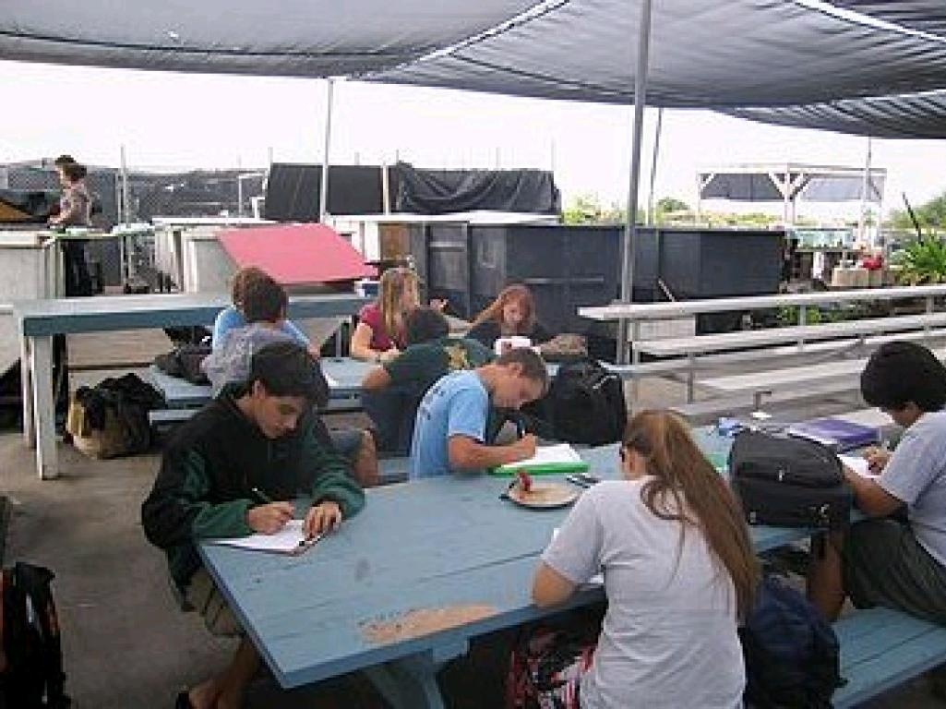
WHEA Then...
The Facilities Challenge

Slide 8
Start-up plan- Explain the HOW
ARE YOU PREPARED?

Slide 9
KEY AREAS
Blended/Virtual Learning
Closure Procedures
Teacher Recruitment
Teacher Licensure Requirements
Facilities- Growth Model

Slide 10
RESPONSIBILITY TO EDUCATE CHILDREN

