Slide 1
Financial Plan
cc: kenteegardin - https://www.flickr.com/photos/26373139@N08

Slide 2
The Financial Plan
Financial Oversight and Management
Operating Budget
cc: kenteegardin - https://www.flickr.com/photos/26373139@N08

Slide 3
Financial Plan Should:
Ensure compliance with all financial reporting requirements
Support the school's plans
Provide reasonable assurance of sustainability
cc: allispossible.org.uk - https://www.flickr.com/photos/60364452@N00

Slide 4
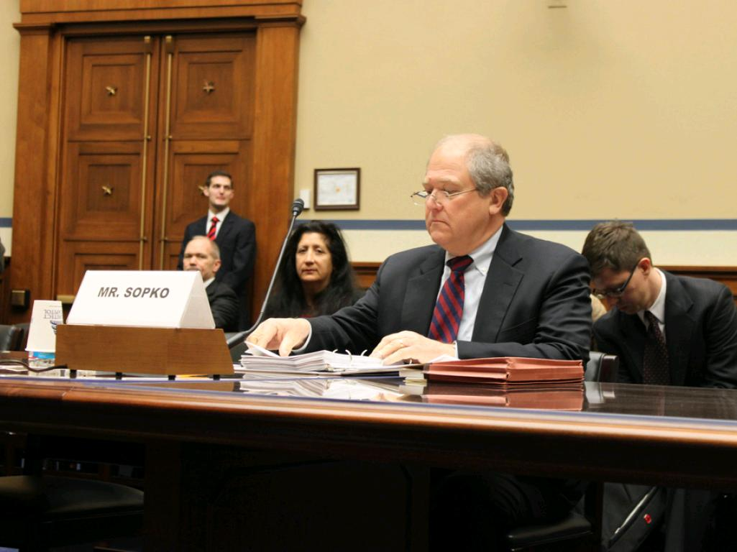
The financial plan should:
Clearly describe roles and responsibilities
Demonstrate strong understanding of internal controls and financial oversight vs. day to day management
cc: Special IG for Afghanistan Reconstruction - https://www.flickr.com/photos/86567949@N04

Slide 5
The financial plan should:
Provide sound criteria and procedures
Bottom line: Does the financial plan make sense when taking the Academic and Organizational Plans into consideration?
cc: oh sk - https://www.flickr.com/photos/7752378@N03

Slide 6
Operating Budget
Operating budget for year zero (start up year) and years 1-3 (operating years)
Must align with the Academic and Organizational Plans
cc: cafecredit - https://www.flickr.com/photos/143215168@N08

Slide 7
Budget Narrative
Describe the Assumptions
Identify the amount and sources and uses of all funds
cc: giulia.forsythe - https://www.flickr.com/photos/59217476@N00

Slide 8
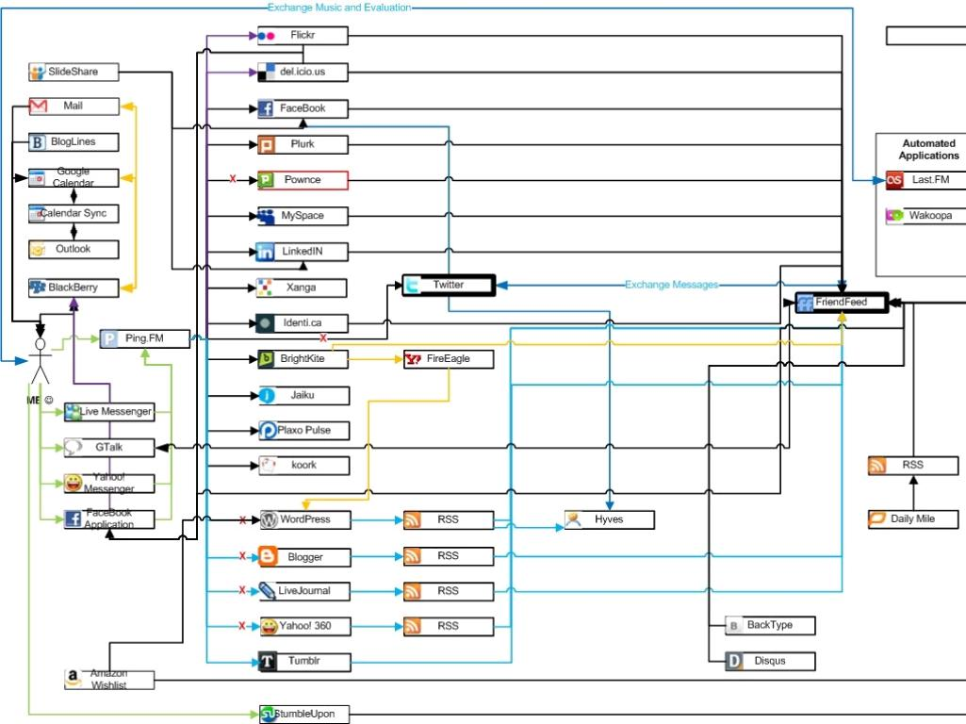
Additional Budget Requirements
Develop contingency plan(s)
Develop a cash flow for years 1-3
Balance sheet to show financial position for years zero - 3
cc: LocalGoogleGuru - https://www.flickr.com/photos/27417567@N02

