Slide 1
ACADEMIC PLAN
cc: giulia.forsythe - https://www.flickr.com/photos/59217476@N00

Slide 2
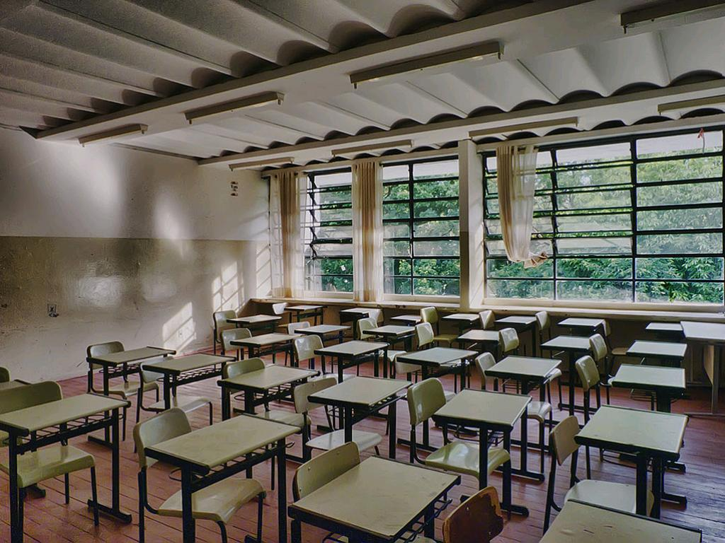
A. Academic Plan Overview, Academic Philosophy, and Student Population
cc: profcarlos - https://www.flickr.com/photos/35083636@N00

Slide 3
Articulate your vision:
Clear outcomes Focused mission Evidenced throughout the academic plan
cc: Cubosh - https://www.flickr.com/photos/39427725@N00

Slide 4
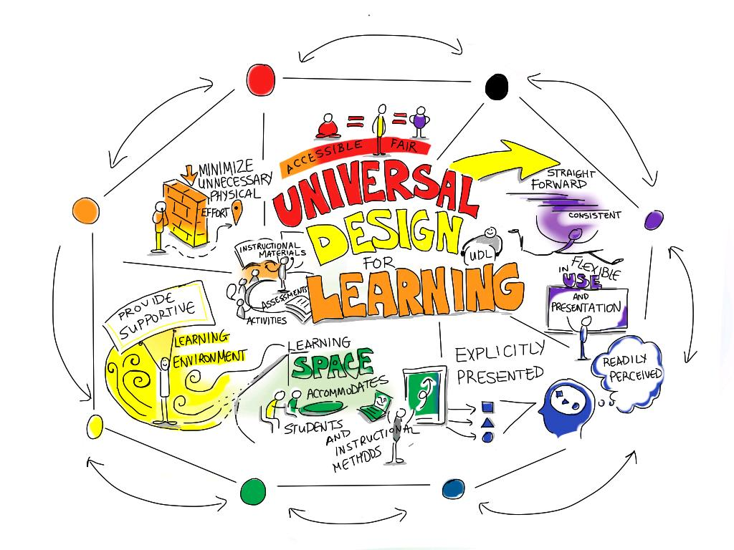
B. Curriculum and Instructional Design
cc: giulia.forsythe - https://www.flickr.com/photos/59217476@N00

Slide 5
C. Special Populations and At-Risk Students
cc: ccarlstead - https://www.flickr.com/photos/27087959@N00

Slide 6
D. Academic Performance Management

Slide 7
E. School Culture

Slide 8
F. Professional Culture and Staffing
cc: Gwenaël Piaser - https://www.flickr.com/photos/22841923@N02

Slide 9
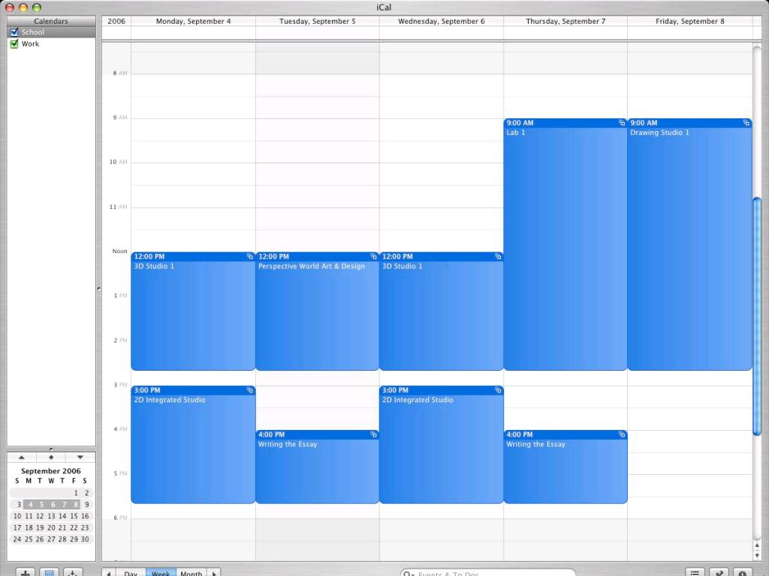
G. School Calendar and Schedule
cc: benkay - https://www.flickr.com/photos/51035729609@N01

Slide 10
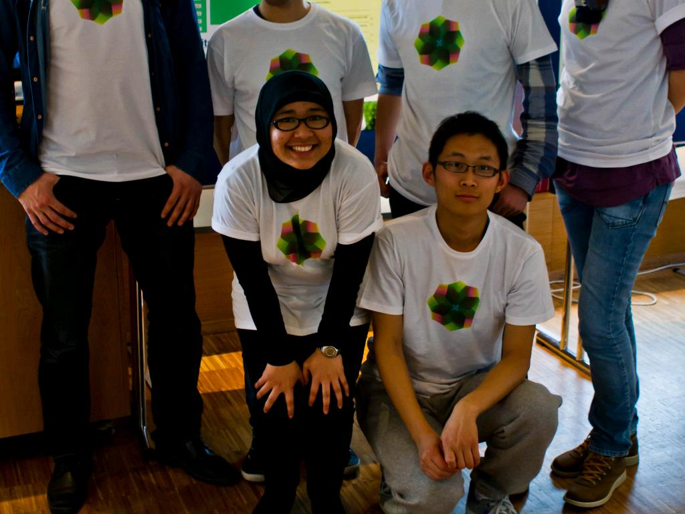
H. Supplemental Programs
cc: Technoport2012 - https://www.flickr.com/photos/76101958@N05

Slide 11
I. Third Party Service Providers
cc: Henry Söderlund - https://www.flickr.com/photos/46563758@N04

Slide 12
J. Conversion Charter School Additional Academic Information

